Slide 1
Building Services
Summer Projects
August 2020

Slide 2

Department Organization
The Department is responsible for the School Division's 26 schools and two service facilities. That is over 2.3 million square feet and 631 acres.
Maintenance
Custodial
Capital
Improvement Program
Environmental Management

Slide 3
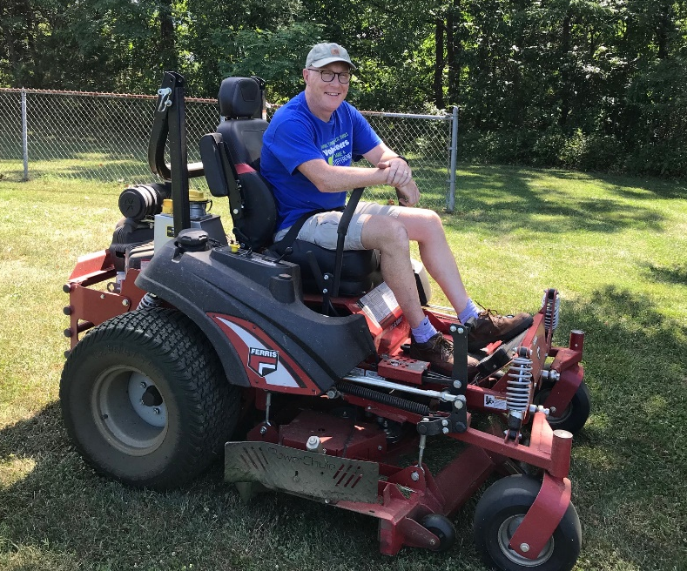
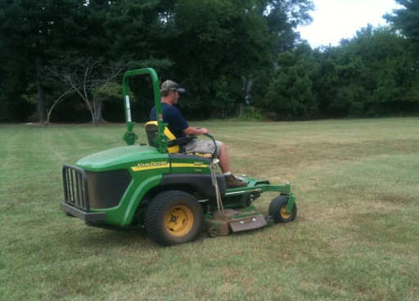
Maintenance
Building & Grounds
Over 40 employees of the Buildings & Grounds Department worked throughout the summer on various tasks including:
  Mowing/grounds
  Moving furniture
  Assisting contractors
  Carpentry work
  Electrical work
  Mechanical work
  Plumbing work

Slide 4
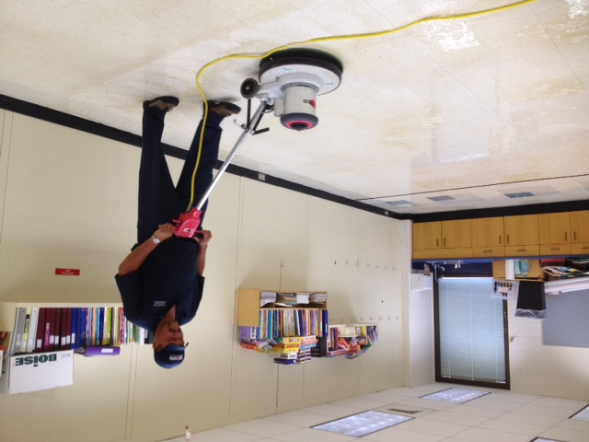
Custodial
Custodial Work
Detailed cleaning of all schools, ceiling to floor.
Floor refinishing
Moved furniture and set up classrooms
Over 140 employees

Slide 5
Custodial
Summer Cleaning Checklist
CEILING
tile replacement
vents
lights cleaning
bulb replacement
high dusting
cobweb removal
WALLS
wall washing
spot removal
bulletin boards
windows/doors
blinds
baseboard
chalkboard
ledges
countertops
cabinets
RESTROOMS
sinks
fountains
walls/stall walls
vents
lights
showers
fixtures
mirrors
floors
doors
CARPET
vacuumed
gum removal
spotted
pre-sprayed
extracted

Slide 6
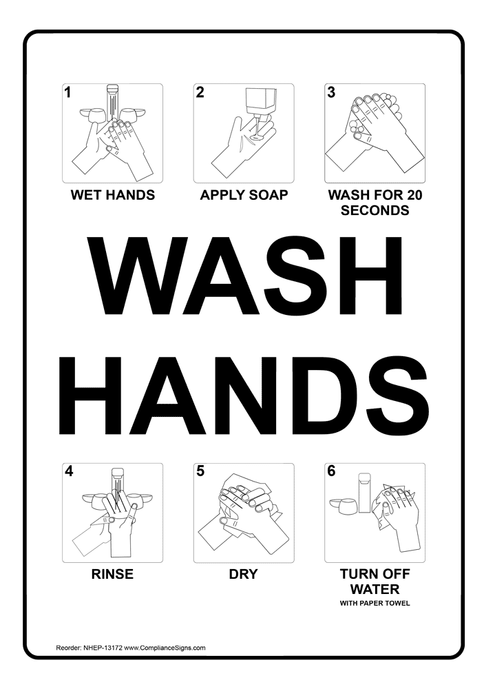

Preparing Indoor Environments
Environmental Management
Physical distancing planning for Stage 2 and Stage 3
Procurement and distribution of COVID-19 preparedness supplies
Signage installation for building entry requirements, proper handwashing, symptom checks, and distancing

Slide 7
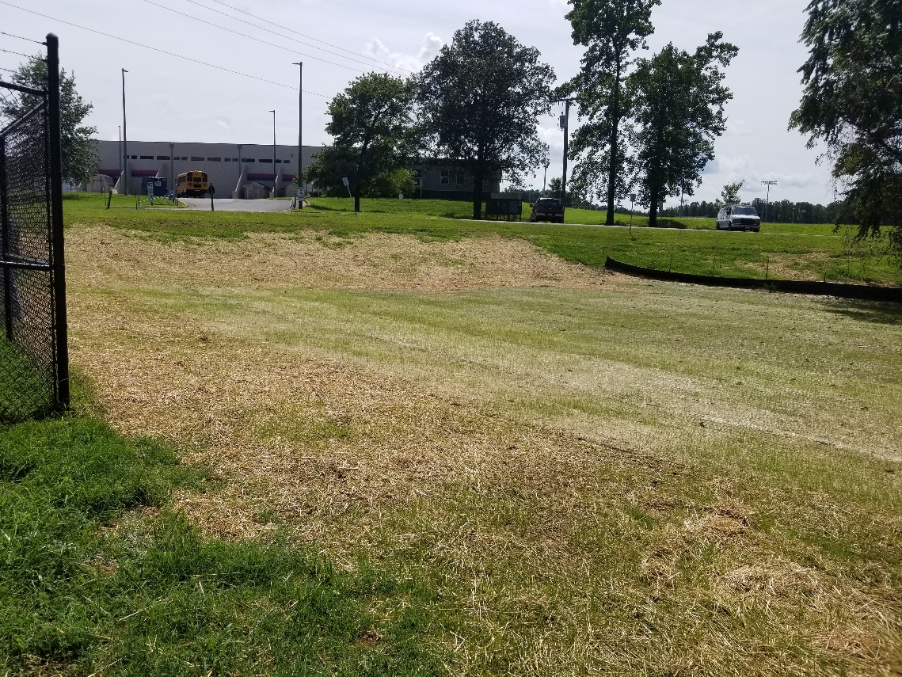
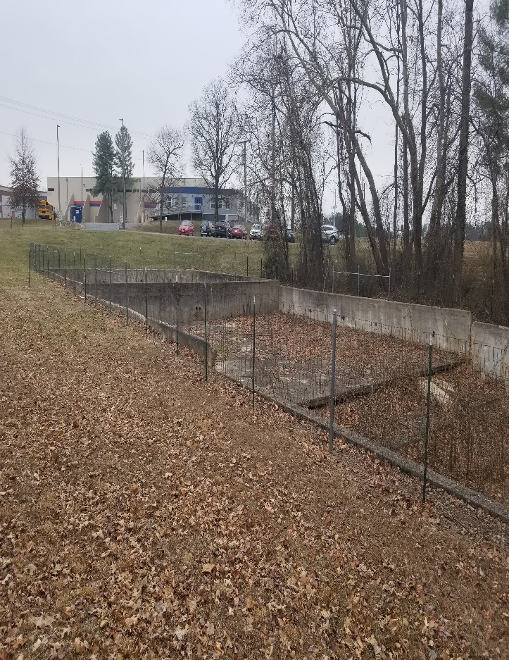
Environmental Management
Environmental Projects
Stony Point Well System Improvements
Rivanna Water & Sewer Authority basin project near Transportation department
After
Before

Slide 8
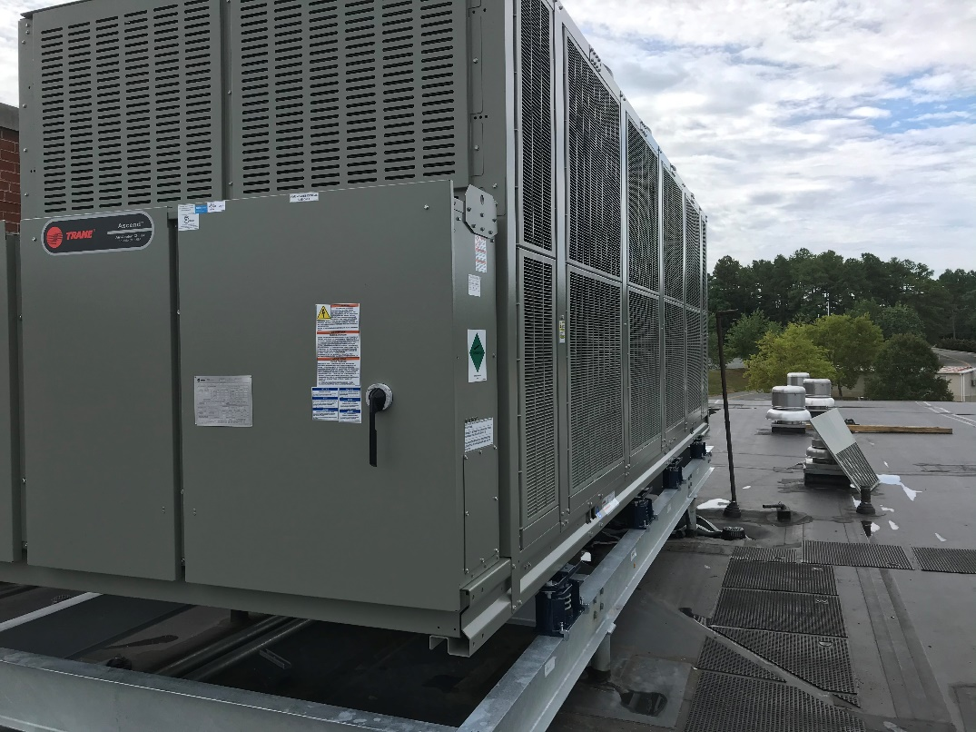
Capital Projects
Albemarle High School
Two new Boiler Replacements
Chiller Replacement
Switchgear Upgrade
Replaced Sewerpump

Slide 9
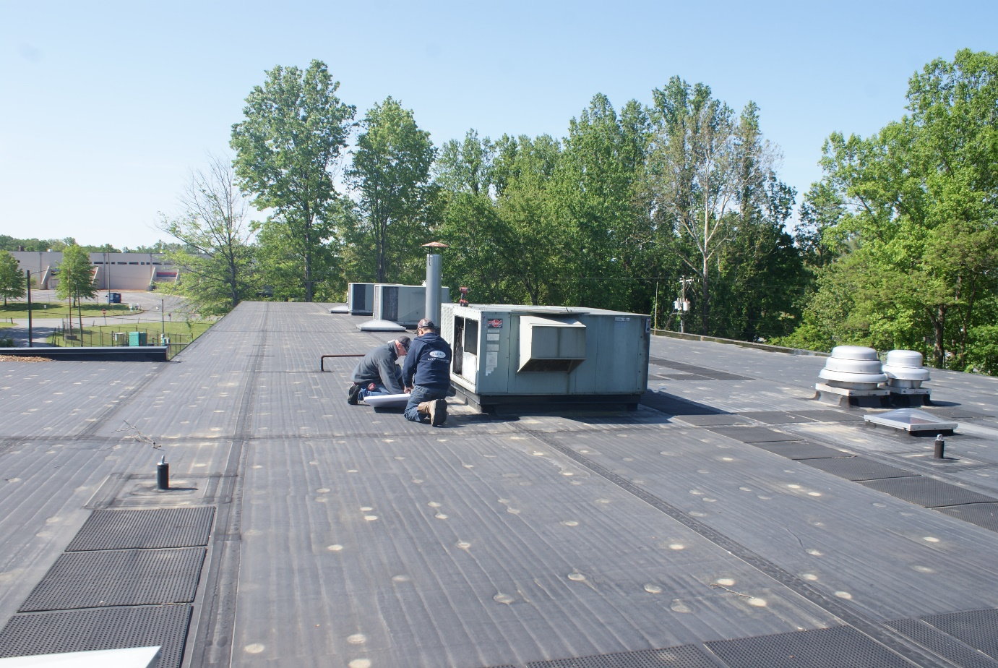
Capital Projects
Vehicle Maintenance Facility
HVAC Replacement
Replacement of 30 year old unit ventilator system with new VRF system to increase efficiency and improve indoor air quality in the offices.

Slide 10
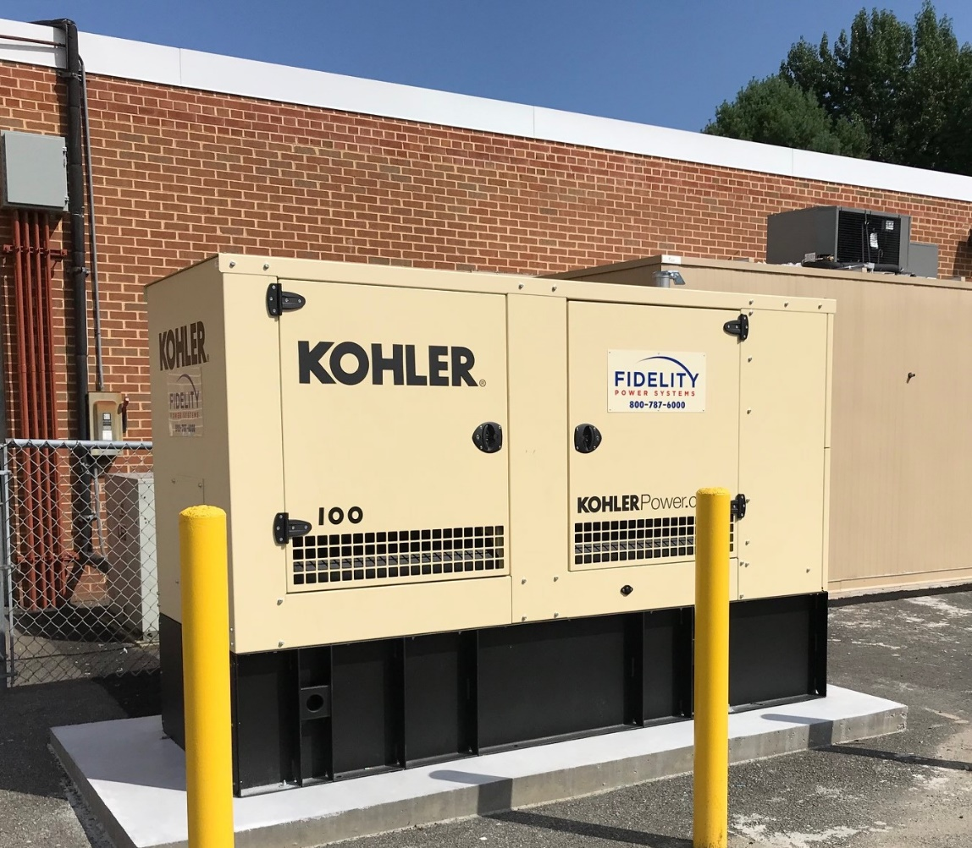
Capital Projects
Generator Install at Henley
Provided back-up power for life safety systems, phones, and various kitchen equipment

Slide 11
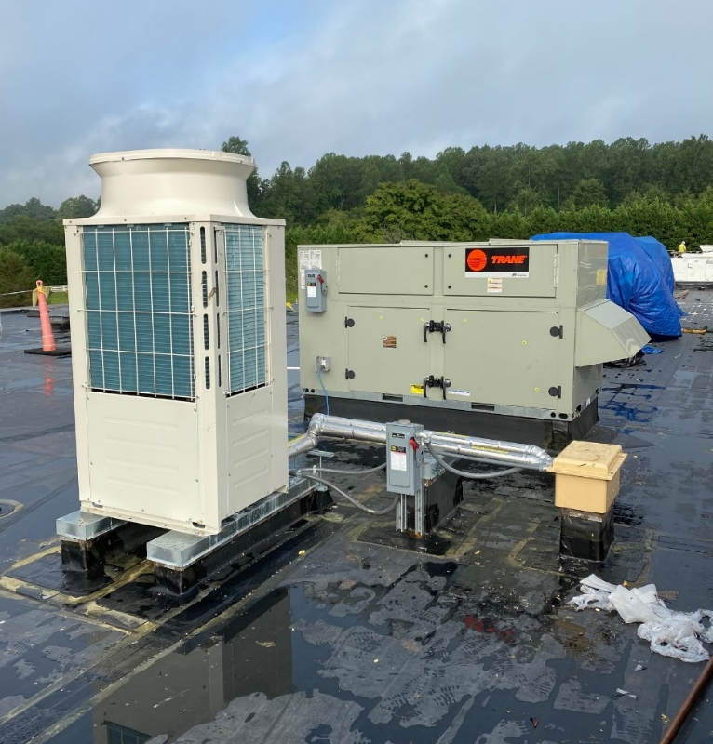
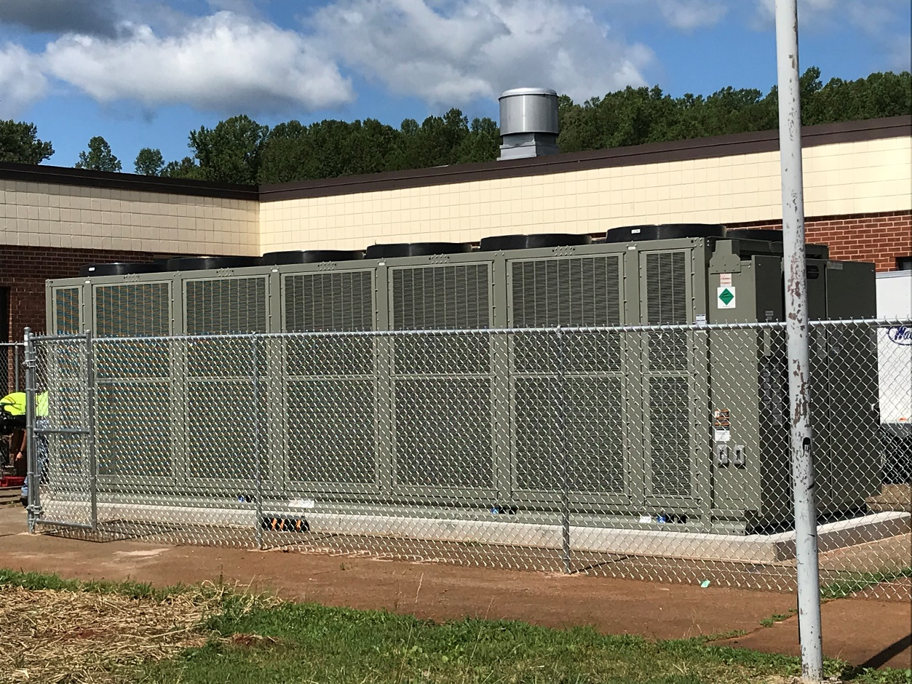
Capital Projects
Walton
Two new Variable Refrigerant Flow (VRF) Condensing Units to upgrade Main Office HVAC system
Installed new Air Cooled Chiller to serve main building

Slide 12
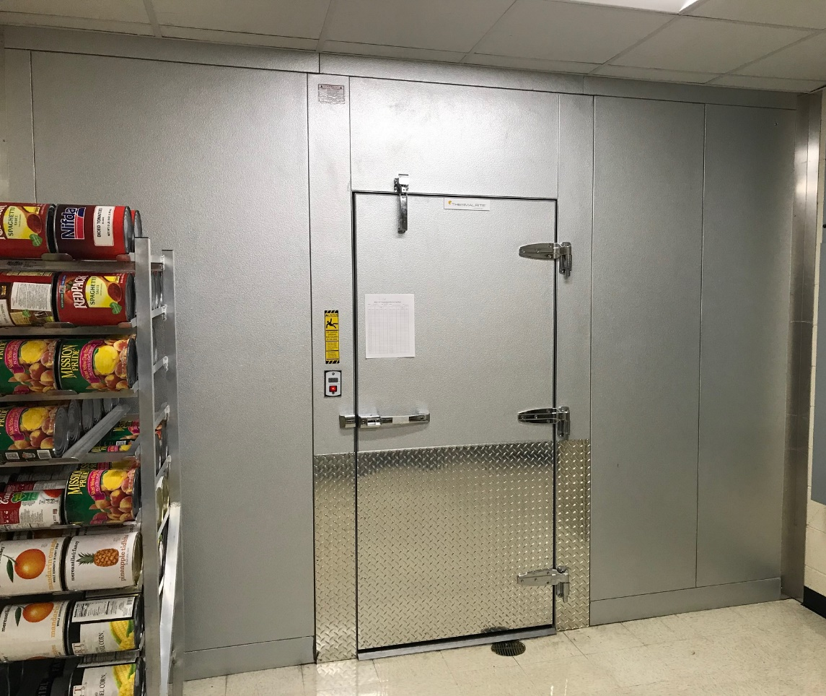
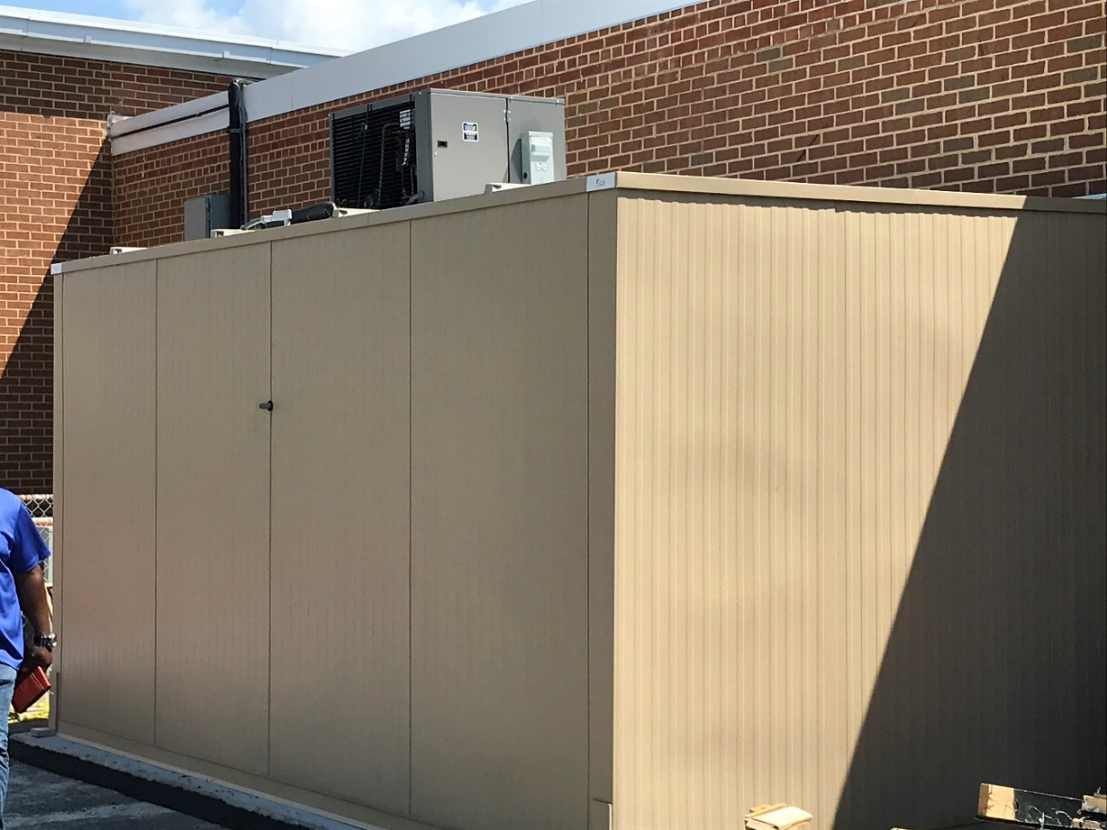
Capital Projects
Jouett and Henley
Walk-in Freezer and Cooler Replacements

Slide 13
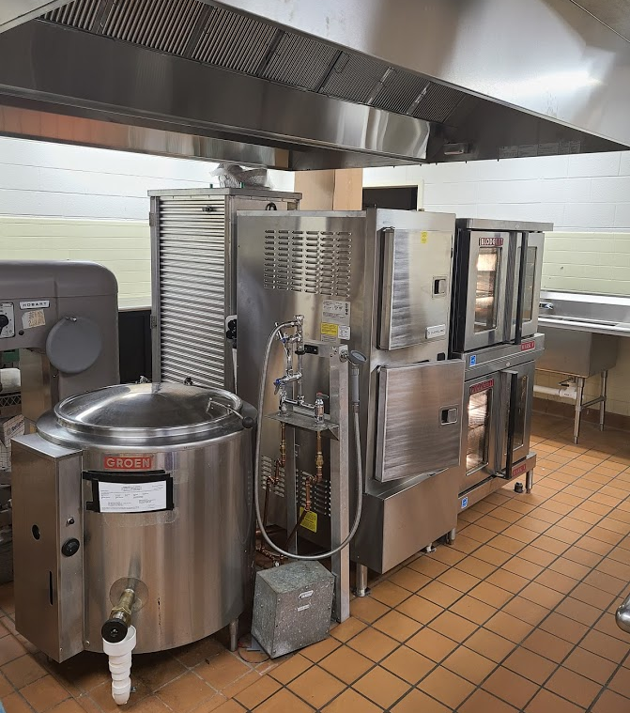
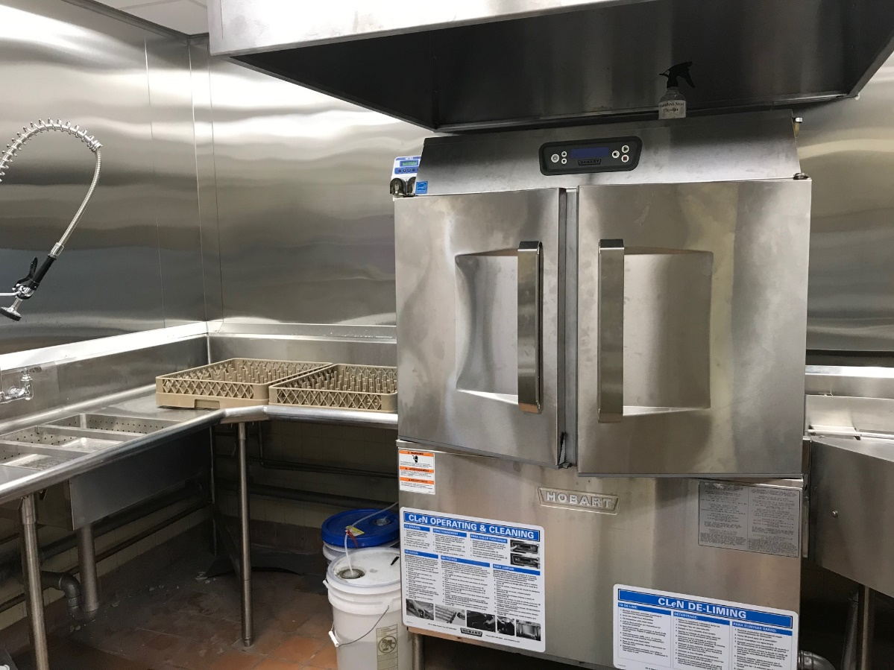
Capital Projects
Brownsville Kitchen Upgrades
  Replacement of kitchen hood
  Upgraded Dishwasher equipment

Slide 14
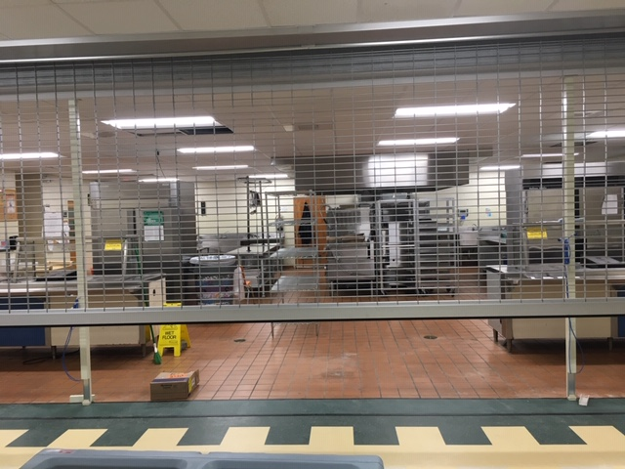
Capital Projects
Jouett Kitchen Upgrades
Improved Serving Line efficiency
Installed Security Gate

Slide 15
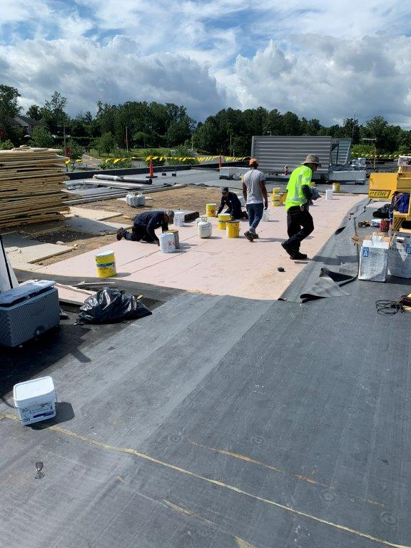
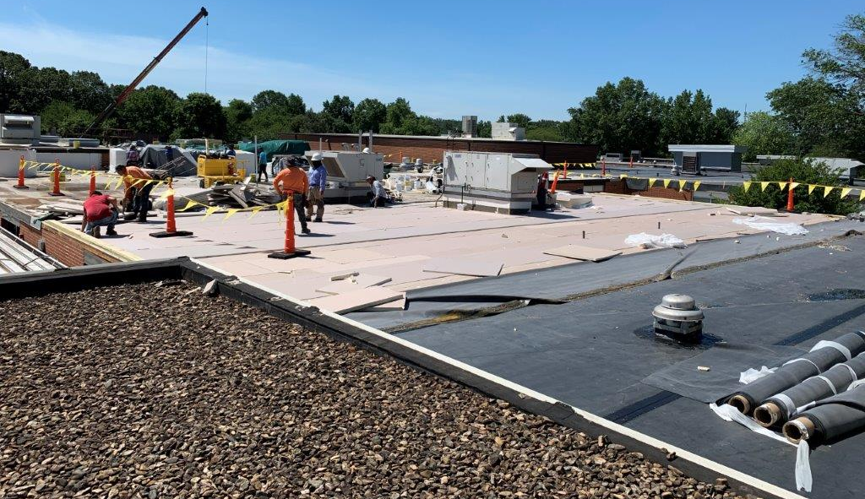
Capital Projects
Roofing Updates
Replaced roofing at:
Walton – 49,776 sq. ft.
Woodbrook – 50,510 sq. ft.
Albemarle High School – 23,736 sq. ft.

Slide 16
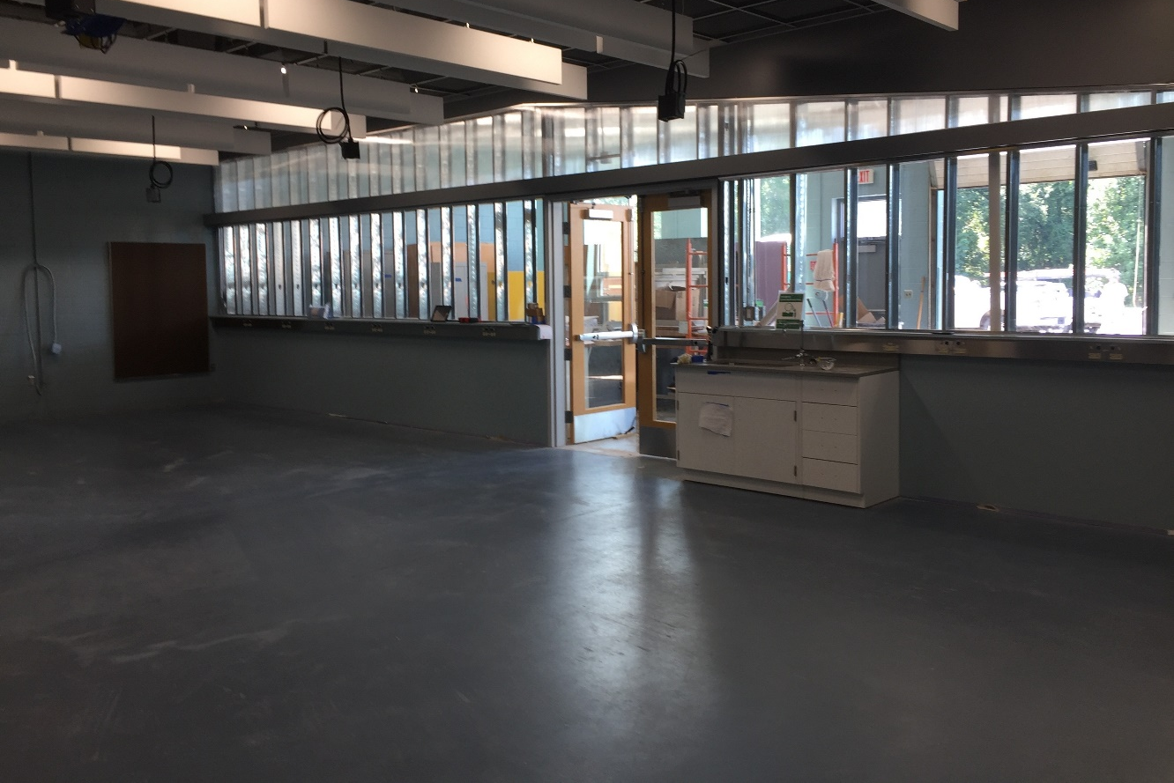
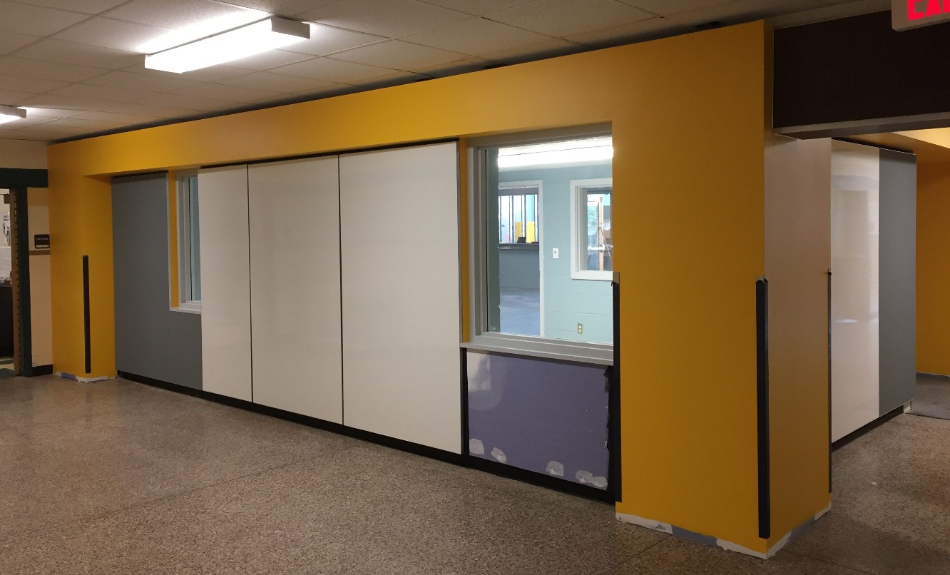
Capital Projects
Learning Space Modernization
Jouett: Renovated CTE Spaces, including casework, walls, technology, electrical, and acoustical upgrades
Walton: added soundproofing between rooms, provided natural light, and painted

Slide 17
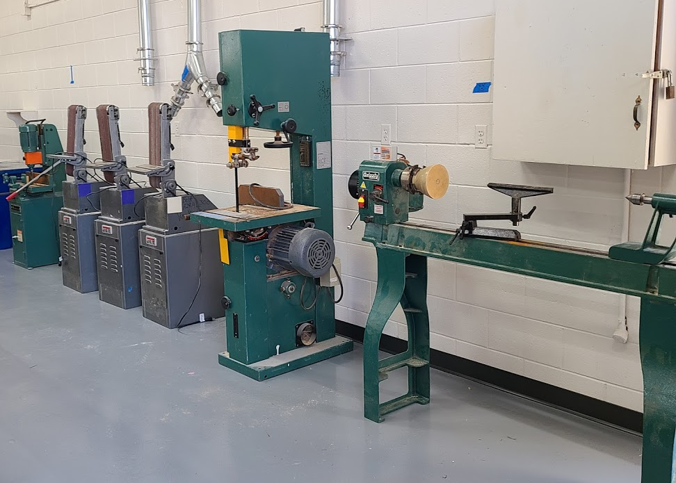
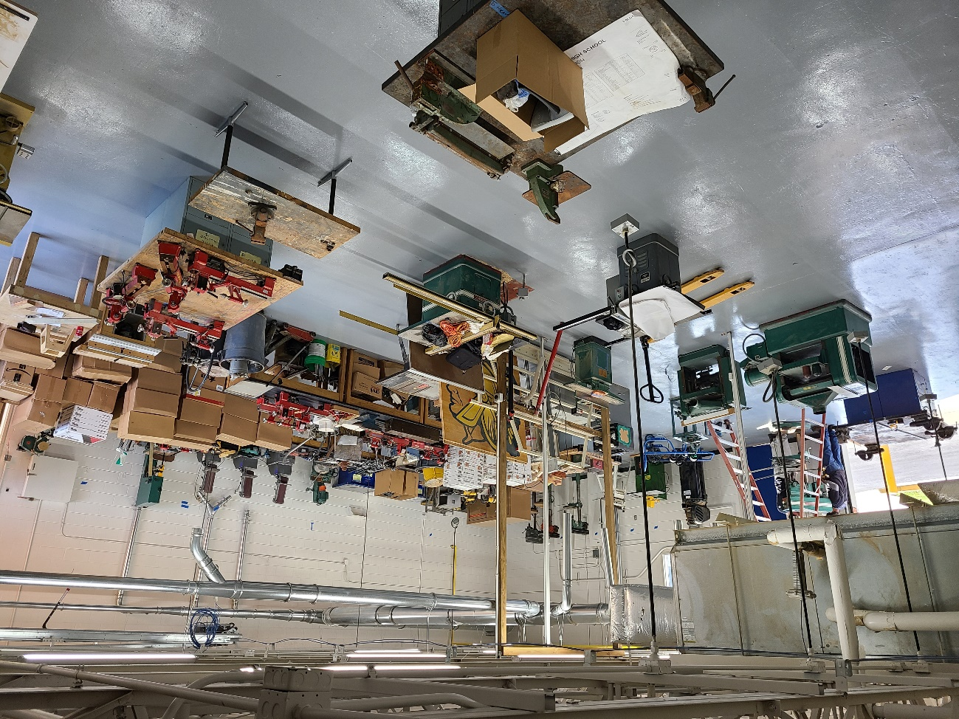
Capital Projects
Western Albemarle High School Shop
Shop area renovations and equipment upgrades

Slide 18
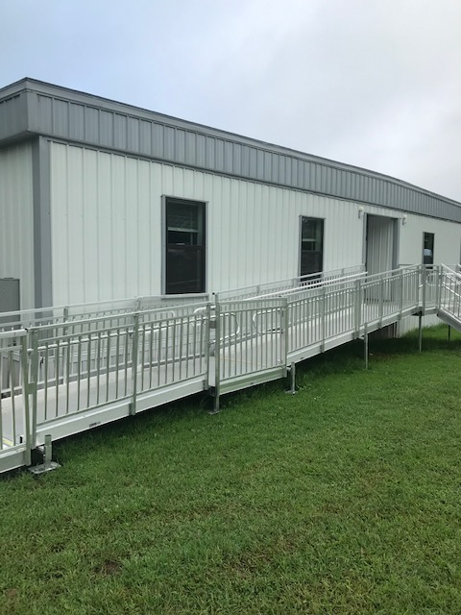
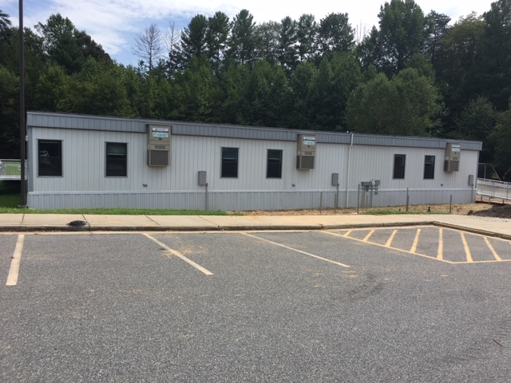
Capital Projects
Baker Butler Trailer
Six classroom trailer added to the Baker Butler campus to alleviate overcrowding.

Slide 19
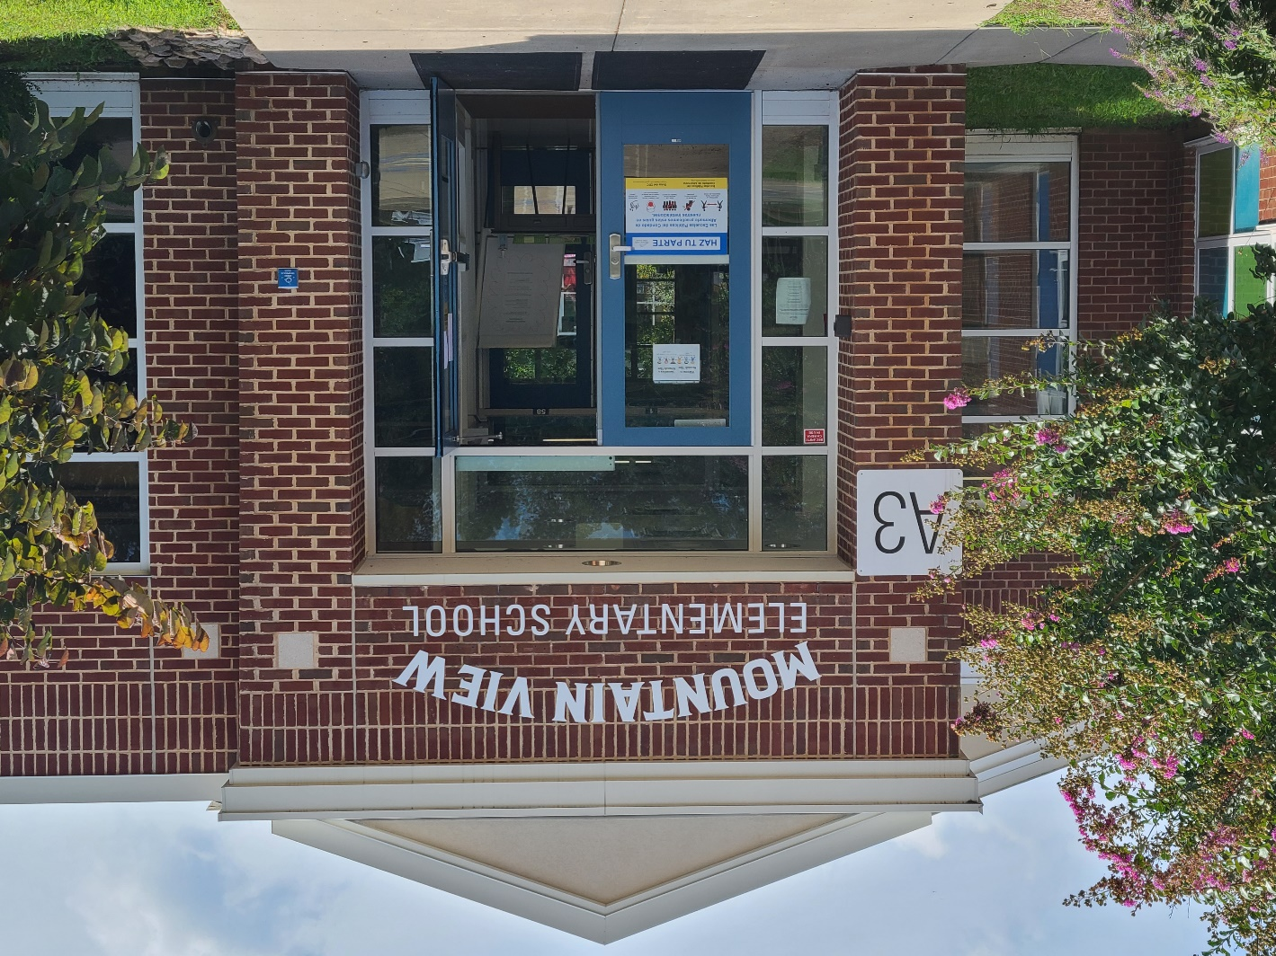
Capital Projects
Mountain View Signage
Installed new signage to reflect the name change of Cale to Mountain View.

Slide 20
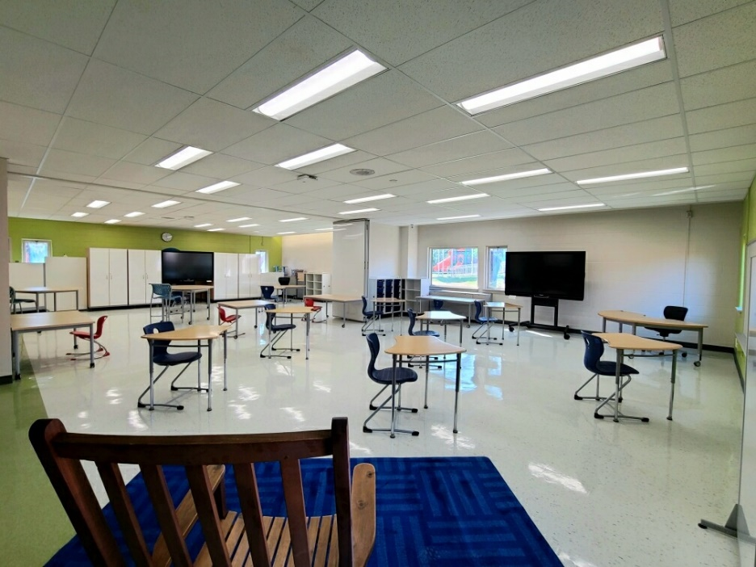
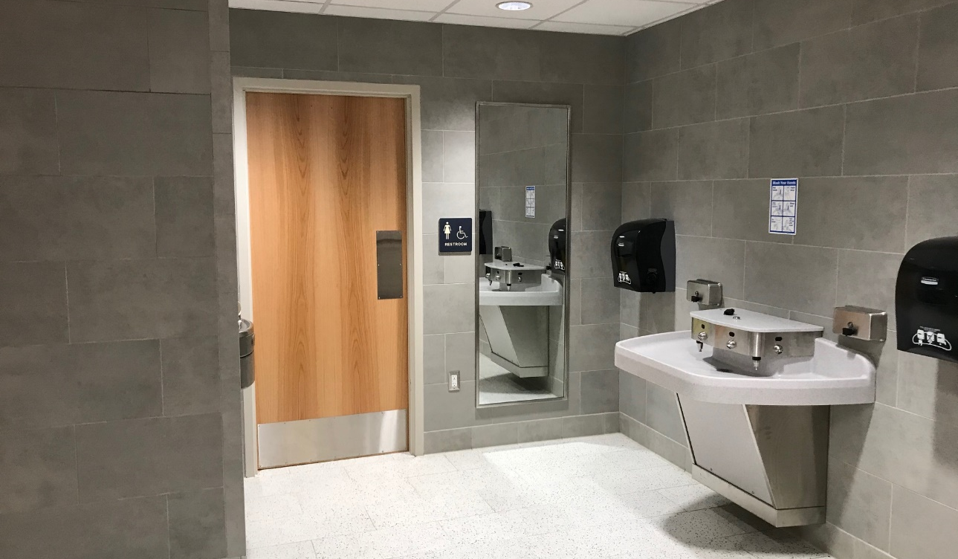
Capital Projects
Scottsville Addition
Adding 17,500 square feet to the building
  four additional classrooms
  two resource classrooms
  two offices
  bathroom
  full-size gym
Improvements to the existing building and site
Expected to be complete for the 2021-2022 school year

Slide 21
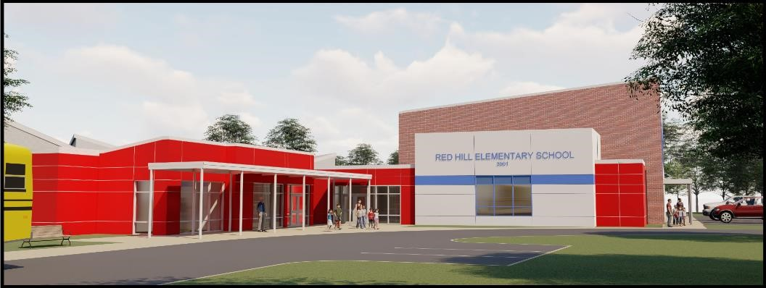
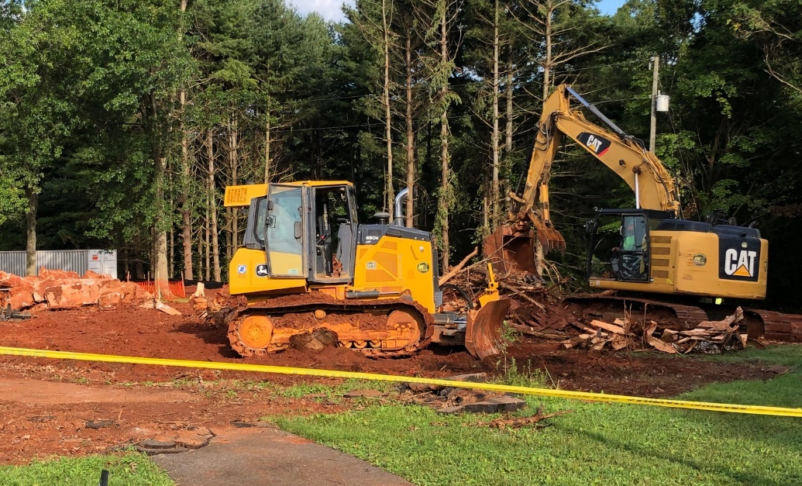
Capital Projects
Red Hill Addition
Adding 6,300 square feet
New gymnasium and support spaces such as staff offices and storage space
Expected opening for the 2021-2022 school year

Slide 22
Acknowledgements
Building Services Department
  Joe Letteri
  Lindsay Snoddy
  Jeff Rohm
  Pam Snyder
  Sheila Hoopmann
  David Via
  Lisa Walker
  George Shifflett
  Nicole Ganoe
  Caitlyn Wetzel
Office of Facilities & Environmental Services
  Blake Abplanalp
  Montie Breeden
  Matt Wertman
  Walter Harris
  Steve Hoffmann
  Tyler Gifford
  Drake Giles
  Neale Craft
  Lisa Glass

Slide 23
Thank you for your support!

